Slide 1


Department of ECE
College of Engineering Guindy, Anna University, Chennai
EC23702 - MINI PROJECT
Single-Layer Hybrid Miniaturized Frequency Selective Rasorber
Single-Layer Hybrid Miniaturized Frequency Selective Rasorber
PRESENTED BY:
AKHSHAIYA S - 2023105507
SRI KUMARAN T S - 2023105535
NAVINA P - 2023105530
AADITHYAN SRIDHARAN - 2023105006
UNDER THE GUIDANCE OF:
DR. GULAM NABI ALSATH
ASSOCIATE PROFESSOR
DEPARTMENT OF ECE

Slide 2
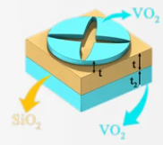
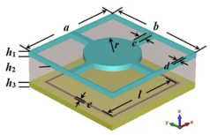
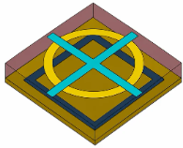
INTRODUCTION TO FREQUENCY SELECTIVE RASORBER (FSR)
A Frequency Selective Rasorber (FSR) is a metasurface that combines the properties of a frequency selective surface (FSS) and an electromagnetic absorber. It is designed to:
  Transmit desired frequencies with very low insertion loss.
  Absorb unwanted frequencies instead of reflecting them.
  Reduce Radar Cross Section (RCS) while maintaining communication capability.
Unlike conventional radomes that only protect antennas, FSRs simultaneously provide electromagnetic transparency and stealth functionality.
Fig.1-3 : Frequency Selective Rasorber

Slide 3
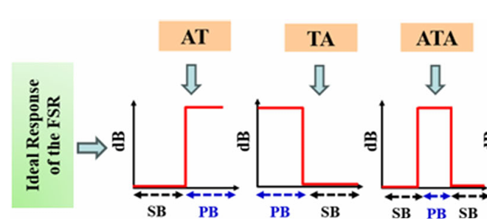
CLASSIFICATION
FSRs are classified based on the relative position of the absorption (A) and transmission (T) bands:
1. AT (Absorption-Transmission)
Absorption occurs at lower frequencies; transmission occurs at higher frequencies.
2. TA (Transmission-Absorption)
Transmission occurs first; higher frequencies are absorbed.
3. ATA (Absorption-Transmission-Absorption)
Two absorption bands surround one transmission band.
Advantage: Absorbs out-of-band interference on both sides of the operating channel while maintaining a lossless in-band communication window - provides excellent stealth.
Why Preferred: Eliminates both lower and higher frequency noise, offering complete 360° electromagnetic shielding compared to single-sided AT or TA types.
Applications: Ideal for 6G stealth radomes, secure integrated sensing-communication (ISAC) systems, and multi-band THz receivers.
Fig.4 : Ideal Response of FSR

Slide 4
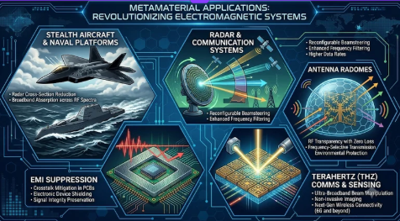
APPLICATIONS
Terahertz (THz) communication and sensing
Stealth aircraft and naval platforms
Radar communication systems
Antenna radomes
Electromagnetic interference (EMI) suppression
Fig.5 : Applications of FSR

Slide 5
PROBLEM STATEMENT
Current Challenge - Growing wireless traffic is saturating the available GHz spectrum.
Why switch to Sub-THz?
  Large unused bandwidth
  100 Gbps data rates
  Ultra-low latency
  High-resolution sensing & imaging
Why FSR?
  Transmits desired frequencies while absorbing unwanted signals.
  Enables efficient 6G communication with EMI suppression.
Research Direction - Miniaturized single-layer hybrid THz FSR with parametric design optimization.

Slide 6
OBJECTIVES
Design a miniaturized Frequency Selective Rasorber (FSR) for the 0-2 THz range, for 6G communication and terahertz sensing applications.
Design and optimize a folded-fractal transmission layer, using stage-wise miniaturization, to get a passband near 1 THz within a 60 µm (0.2λ₀) unit cell.
Design a graphene-loaded absorption layer with wideband absorption, targeting about 70% fractional bandwidth.
Integrate the transmission and absorption layers into a single-layer hybrid FSR, with low insertion loss (about 3 dB) and wideband absorption.
Analyse the angular stability (0°, 15°, 30°) and polarization stability (TE and TM modes) of the integrated FSR, and confirm that the broadband response does not change.

Slide 7
PROPOSED METHODOLOGY
Objective: Design a miniaturized Frequency Selective Rasorber (FSR) for the 0-2 THz frequency range using CST Studio Suite.
FSR Function: Transmits desired frequencies while absorbing unwanted electromagnetic waves.
Methodology: Design and simulate the FSR unit cell.
    Perform parametric analysis by varying:
      Periodicity
      Resonator dimensions
      Substrate thickness
      Metal layer dimensions
Expected Outcome: Optimized miniaturized FSR with low in-band insertion loss and wideband out-of-band absorption.
Applications: Terahertz communications, sensing, imaging, filtering, and electromagnetic shielding.

Slide 8
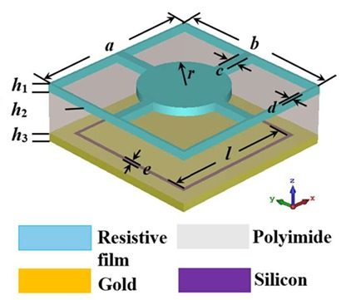
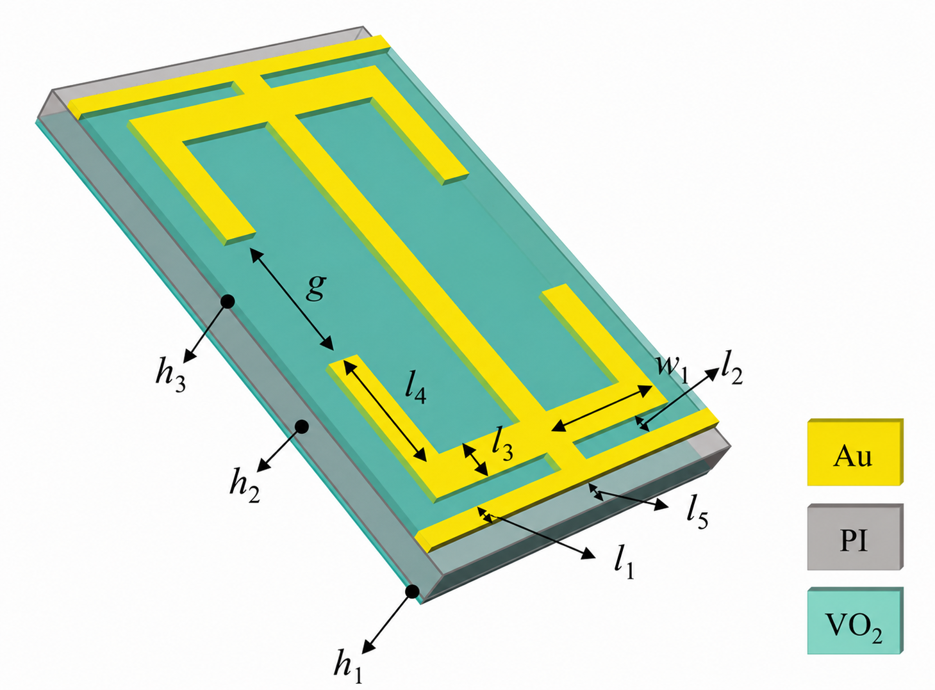
LITERATURE SURVEY
S.NO | ARTICLE | PROTOTYPE | RESULTS
1 | Optically Reconfigurable Wideband THz FSR/Absorber (2025) | Px=Py=20um,Air space:75-100um, Substrate: Polyimide (1um), Metal: Gold, Lumped elements: Nil | Transmission frequency: 3 THz Insertion loss:2.6db Absorption band:1-10 THz (UWB) Filtering response: A-T-A Application: THz radar, radome, RCS reduction
2 | VO₂-Based THz Device Switchable Between Absorption & Transmission (2024) | Px=Py=160 x 100um,Air space: open boundary, Substrate: Polyimide (25um), Metal: Gold, Lumped elements: Nil | Transmission frequency: 0.486, 1.053 THz Insertion loss:<=0.46db Absorption frequency: 0.44, 1.25, 1.93, 2.45 THz Filtering response: A-T-A Application: THz imaging, sensing, wireless communication

Slide 9
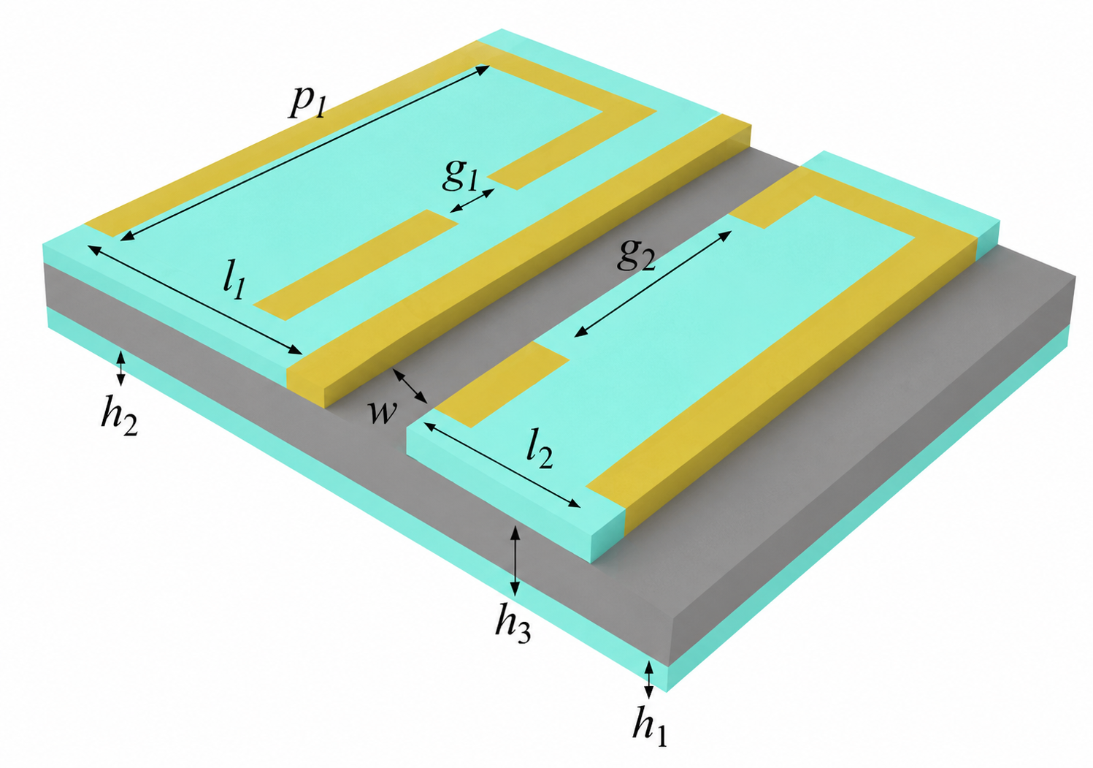
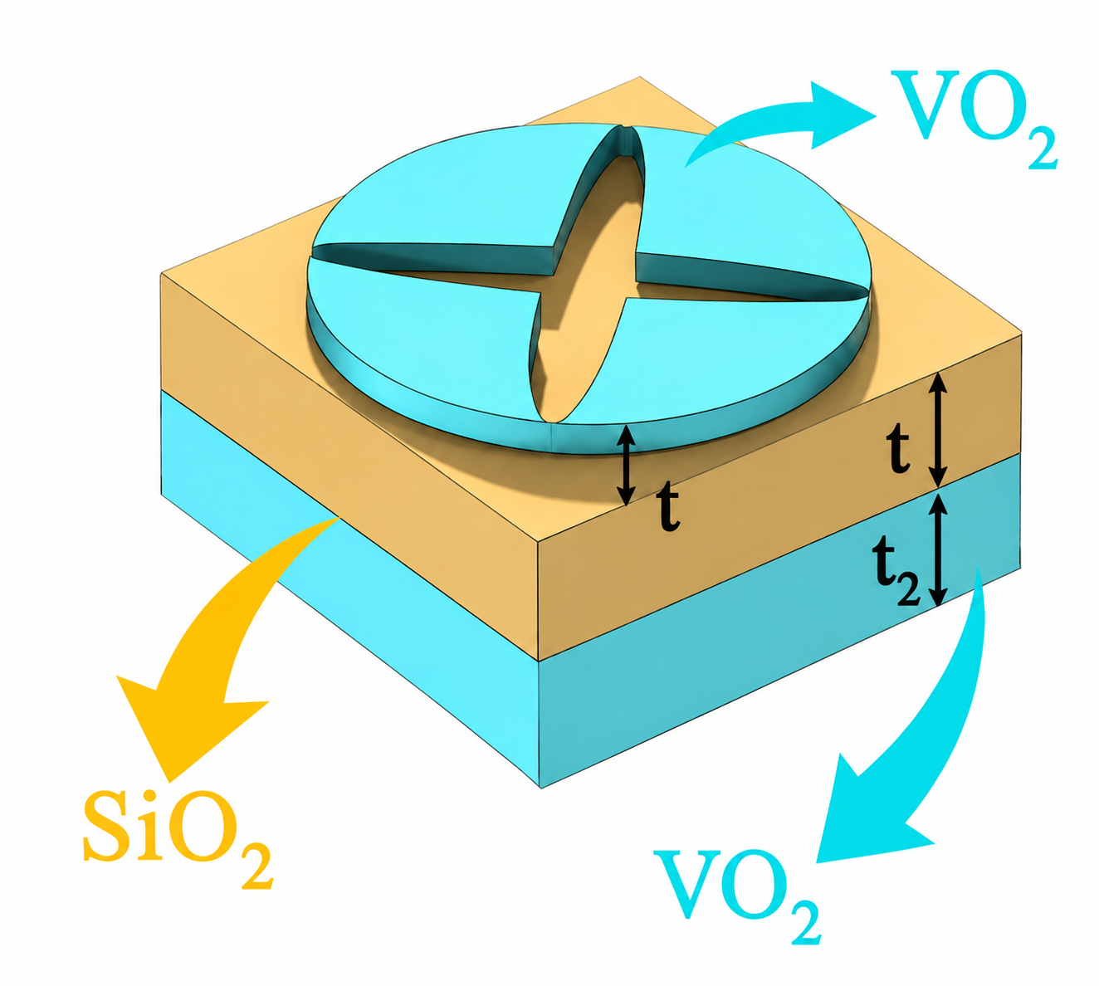
3 | VO₂-Based THz Device Switchable Between Transmission & Absorption (2022) | Px=Py=150um, Air space: open boundary, Substrate: Polyimide (20um), Metal: Gold, Lumped elements: Nil | Transmission frequency: 0.90 THz Insertion loss:0.87 dB Absorption frequency: 0.66, 1.22, 2.14, 2.48 THz Filtering response: A-T-A Application: THz switching, sensing, security
4 | THz Smart Switch Using VO₂ Metamaterial (2024) | Px=Py=35um, Air space: open boundary, Substrate: SiO2(75um), Metal: VO2, Lumped elements: Nil | Transmission band: 5.3–10 THz Insertion loss:0.65 dB Absorption band: 3.6–9.4 THz Filtering response: A-T-A Application: Smart windows, NDT, THz imaging

Slide 10
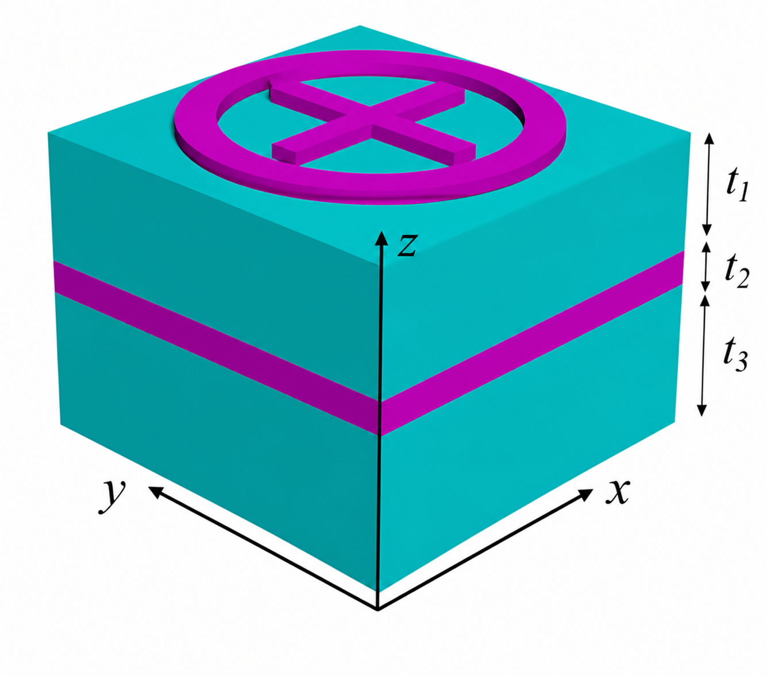
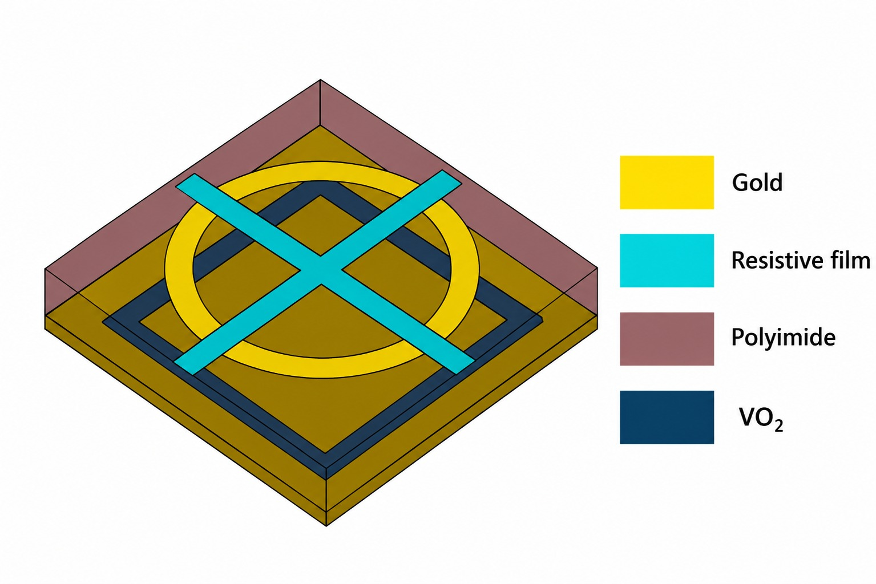
5 | Bifunctional THz Metamaterial with Switchable Transmission & Broadband Absorption (2024) | Px=Py=24um, Air space: open boundary, Substrate: Topas (9um), Metal: VO2, Lumped elements: Nil | Transmission band: 1–10 THz Insertion loss: <0.46 dB Absorption band: 2.54–7.65 THz Filtering response: A-T-A Application: THz modulation, stealth, broadband absorber
6 | Thermally Controlled Multifunctional Metamaterial Absorber with Switchable Wideband Absorption and Transmission at THz Band (2023) | Px=Py=14um, Air space: open boundary, Substrate: Polyimide (2um), Metal: Gold, Lumped elements: Nil | Transmission frequency: 5.15 THz Insertion loss:4.29 dB Absorption band: 3.31-10 THz Filtering response: A-T-A Application: Radar stealth, Selective transceivers

Slide 11
INFERENCES FROM LITERATURE REVIEW
Limited Focus on 6G Sub-THz Band - Most reported THz FSRs operate in the 2.5-10 THz range. Very few designs specifically target the 0-2 THz spectrum required for 6G communications and THz sensing.
Miniaturization Remains a Challenge - Existing unit cells have electrical lengths of 0.20-1.30λ₀. Achieving sub-wavelength (<0.3 λ₀) compact FSRs at sub-THz frequencies remains difficult.
Conventional Design Methodology - Existing works rely on design optimization using CST/COMSOL. This approach is time-consuming and inefficient for multi-objective FSR design.
Research Gap - There is a need for a compact, passive FSR operating in the 0-2 THz band with high in-band transmission and wideband out-of-band absorption ensuring suitability for 6G and sensing applications.

Slide 12
DESIGN SPECIFICATIONS
Operating Frequency | 0-2 THz
Center Design Frequency (Initial) | 1 THz
Unit Cell Size (Periodicity) | 60 µm × 60 µm, 0.2 * lamda
Substrate Material | Silicon Dioxide (SiO₂)
Substrate Thickness | 4 µm
Conductive Layer | Gold
Gold Thickness | 0.5 µm
Boundary Conditions | Unit Cell (Periodic) in X and Y directions
Performance Parameters | S11, S21

Slide 13
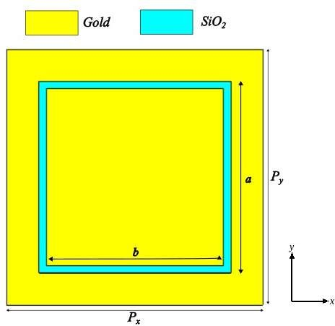

RESULTS
TRANSMISSION LAYER - STAGE 0
Dimensions:
120μm Unit Cell
360μm Current Path
11.5μm SiO₂ Substrate thickness
0.5μm Gold thickness
The conventional square loop resonator with a 120 μm unit cell produces a transmission resonance around 0.64 THz, confirming that the basic loop geometry supports the required LC resonance.
However, the relatively large unit cell limits angular stability, making it unsuitable for compact THz metasurface applications.
Therefore, the resonator geometry is further compacted and folded to fit within a 60 μm unit cell.
13

Slide 14
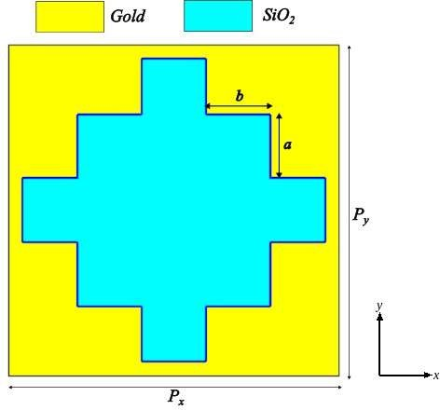
RESULTS
TRANSMISSION LAYER - STAGE 1
Dimensions:
60μm Unit Cell
220μm Current Path
11.5μm SiO₂ Substrate thickness
0.5μm Gold thickness
The Simple Cross Resonator structure exhibits a broad transmission response without a distinct passband near 1 THz, indicating that the current path and effective LC are insufficient to support the desired resonance.
Need for path-length enhancement through fractal folding, which increases the effective inductance and distributed capacitance while maintaining the same unit cell size, enabling resonance to be shifted towards the target 1 THz.

Slide 15
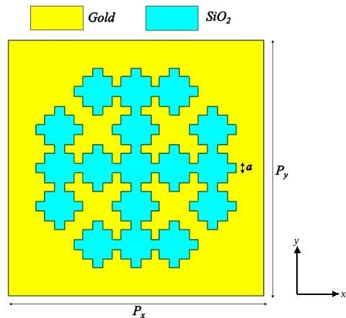
RESULTS
TRANSMISSION LAYER - STAGE 2
Dimensions:
60μm Unit Cell
609.331μm Current Path
11.5μm SiO₂ Substrate thickness
0.5μm Gold thickness
Increasing the effective current path to 609.331 µm introduces sufficient distributed inductance and capacitance to establish a defined transmission passband centered at 1.17 THz, validating the effectiveness of the folded fractal geometry.
The result demonstrates that path-length enhancement significantly lowers the resonant frequency while maintaining the same unit cell, confirming the miniaturization capability of the proposed resonator.

Slide 16
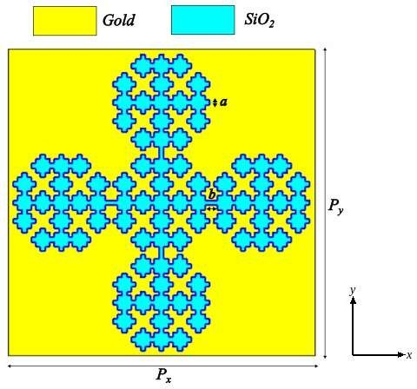
RESULTS
TRANSMISSION LAYER - STAGE 3
Dimensions:
60μm Unit Cell
1217.6μm Current Path
4μm SiO₂ Substrate thickness
0.5μm Gold thickness
Increasing the effective current path to 1217.6 µm while maintaining a 60 µm unit cell creates the optimum distributed LC network, shifting the transmission resonance to the target 1 THz with a passband spanning approximately 0.973-1.021 THz.
The folded fractal geometry maximizes current confinement and inter-element capacitive coupling, demonstrating successful electrical miniaturization by achieving 1 THz resonance without increasing the unit cell dimensions.

Slide 17



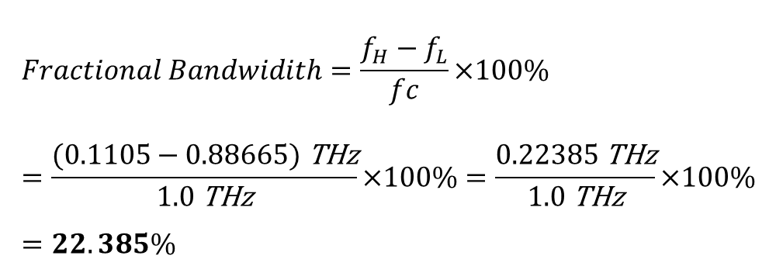
RESULTS
EVOLUTION OF TRANSMISSION LAYER
$$Fractional Bandwidith=\frac{{f_{H}−f}_{L}}{fc}×100\%=\frac{(0.1105−0.88665)\text{ THz}}{1.0\text{ THz}}×100\%=\frac{0.22385\text{ THz}}{1.0\text{ THz}}×100\%=22.385\%$$
f_{H}- upper frequency, f_{L}- lower frequency, f_{c}- centre frequency

Slide 18
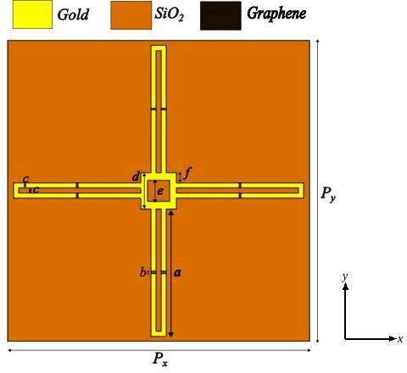

RESULTS
ABSORPTION LAYER - STAGE 1
Dimensions:
60μm Unit Cell
30μm SiO₂ Substrate thickness
0.5μm Gold thickness
The initial closed-loop structure consists of a central square connected to cross-shaped stems with closed loops.
The limited current path restricts the achievable electrical length, resulting in a relatively high-frequency response.
The structure fails to achieve lower-frequency absorption band.
The frequency range is achieved from 0.92 -1.6THz@-10dB.

Slide 19
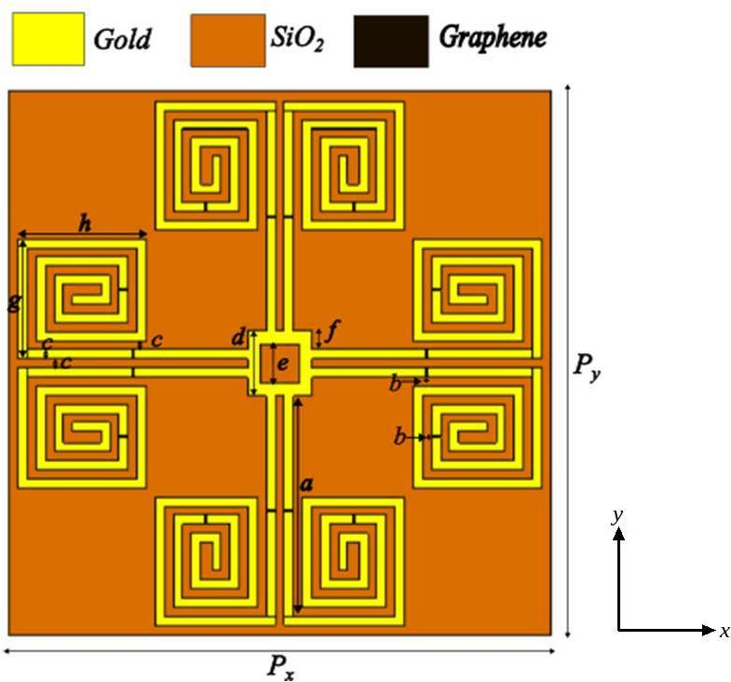
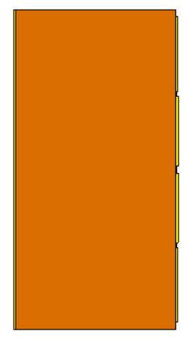
RESULTS
ABSORPTION LAYER - STAGE 2
Dimensions:
60μm Unit Cell
30μm SiO₂ Substrate thickness
0.5μm Gold thickness
0.001μm Graphene thickness
The closed loops were opened and convoluted into square spiral structures with 1 μm gold width and 1 μm inter-turn gap, increasing the effective current path .
The longer path introduced increases distributed inductive and inter-turn capacitive loading.
This results in shifting the lower cutoff to approximately 0.81 THz.
However, the available number of turns was still insufficient to reach the desired lower-frequency region.

Slide 20
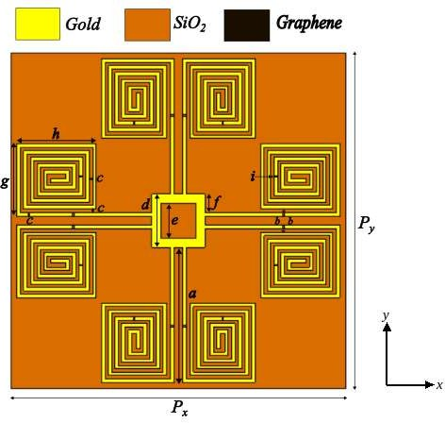
RESULTS
ABSORPTION LAYER - STAGE 3
Dimensions:
60μm Unit Cell
30μm SiO₂ Substrate thickness
0.5μm Gold thickness
0.001μm Graphene thickness
The gold width and inter-turn gap were reduced to 0.6 μm, allowing more turns to be accommodated within the same unit cell and further increasing the effective electrical path.
This enhances the distributed inductive and capacitive loading resulting in shifting the response towards lower frequency bands.
Graphene was introduced on the feeder stem and the 3rd spiral turn providing effective coupling with the resonant electromagnetic mode.
The resistive and reactive loading improves impedance matching, resulting in a continuous −10 dB response from 0.678 to 1.377 THz.

Slide 21
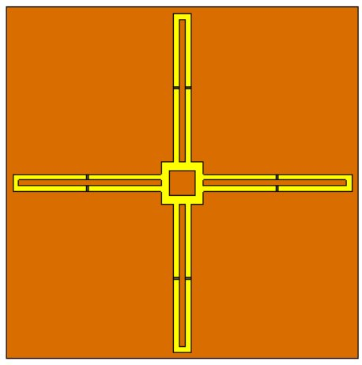
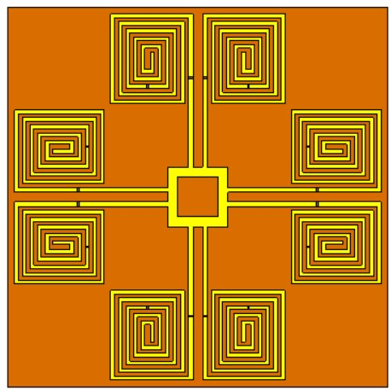
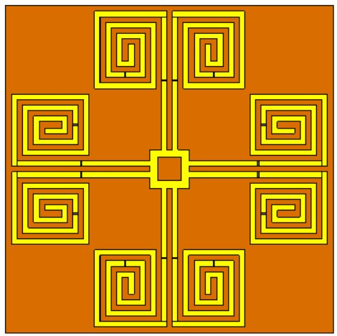
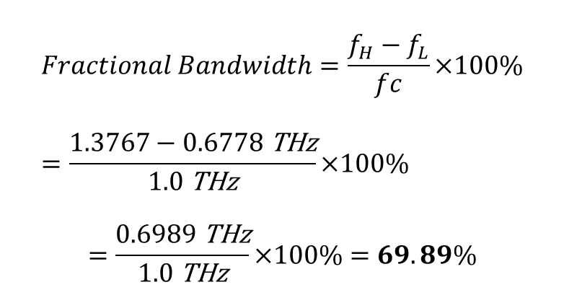
RESULTS
EVOLUTION OF ABSORPTION LAYER
$$Fractional Bandwidth=\frac{{f_{H}−f}_{L}}{fc}×100\%=\frac{1.3767−0.6778\text{ THz}}{1.0\text{ THz}}×100\%$$
$$=\frac{0.6989\text{ THz}}{1.0\text{ THz}}×100\%=69.89\%$$
f_{H}- upper frequency, f_{L}- lower frequency,
f_{c}- centre frequency

Slide 22
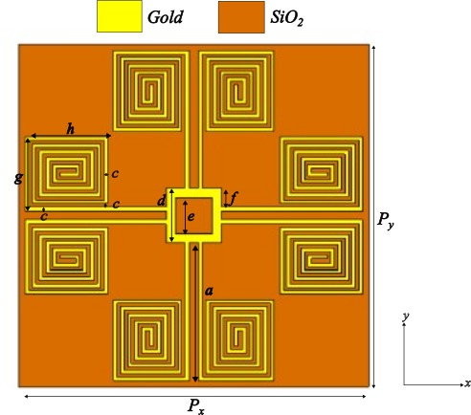
RESULTS
ABSORPTION LAYER – GRAPHENE IMPACT
Dimensions:
60μm Unit Cell
30μm SiO₂ Substrate thickness
0.5μm Gold thickness
The response shows isolated resonances and returns close to 0 dB between them in the absence of graphene flakes in the structure.
Graphene introduces additional resistive loss and reactive loading, improving impedance matching and broadening the low-reflection response.
The comparison confirms that graphene, particularly at the stem and 3rd spiral turn, is important for achieving the broadband response.

Slide 23
RESULTS
IMPACT OF GRAPHENE AT DIFFERENT LOCATIONS
Graphene placement strongly influences the resonant response of the spiral.
Placing graphene at the outer turn, tip, stem, or inner turn produces different resonance positions and bandwidths due to the non-uniform current and field distribution along the spiral.
These locations result in either isolated resonances or regions where the response rises above the −10 dB level.
The intermediate turn (3rd turn) provides the most effective coupling with the resonant mode, allowing graphene to introduce suitable resistive loss and reactive loading.
This improves impedance matching and produces the desired broadband −10 dB response from approximately 0.678 to 1.377 THz, making the 3rd-turn location the selected configuration.

Slide 24

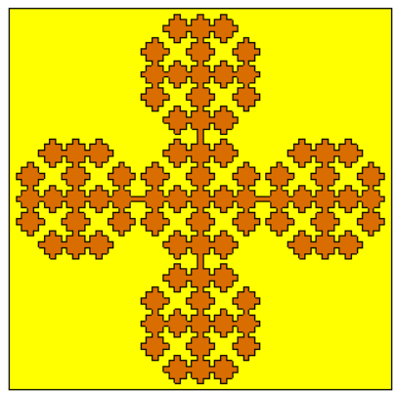
RESULTS
COMBINED RESPONSE
Dimensions:
60μm Unit Cell
30μm SiO₂ Substrate thickness
0.5μm Gold thickness
The optimized transmission and absorption layers are combined within the same 60 μm unit cell to obtain the overall electromagnetic response.
The combined structure exhibits a transmission resonance around 0.81 THz, while the absorption layer contributes broadband low-reflection behavior across the target frequency range.

Slide 25
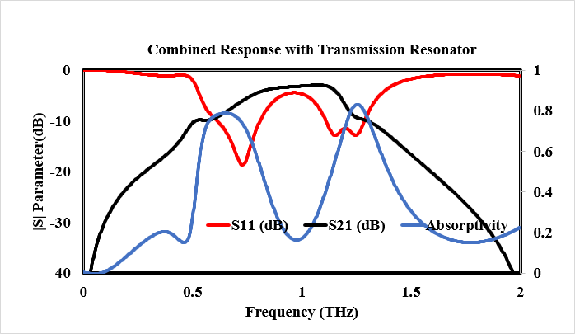
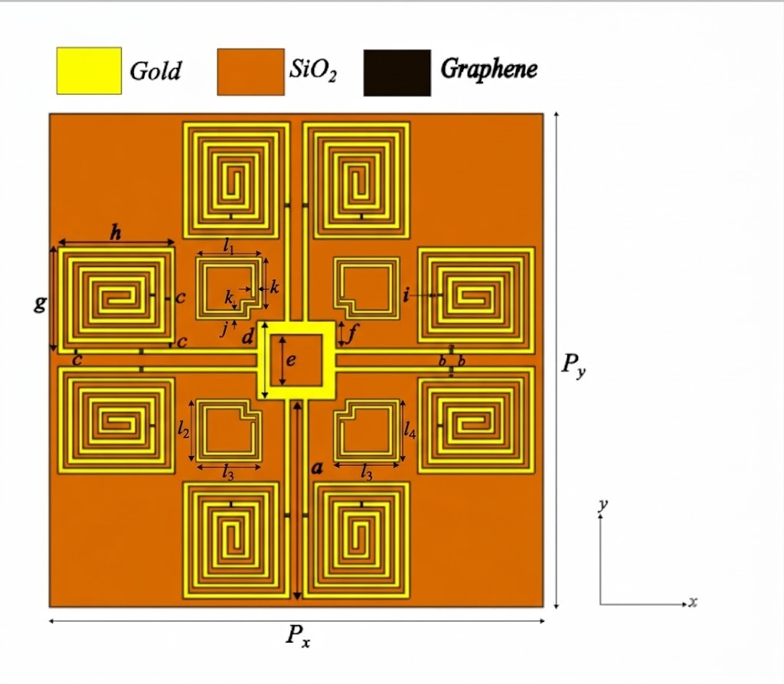
RESULTS
COMBINED RESPONSE WITH TRANSMISSION RESONATOR
Dimensions:
60μm Unit Cell
30μm SiO₂ Substrate thickness
0.5μm Gold thickness
The absorption layer and the folded-fractal transmission resonator are integrated on one SiO₂ substrate within the same 60 μm unit cell, giving an A-T-A response.
Transmission resonator: passband centred at ≈1.07 THz with peak S21 ≈ −3 dB, i.e. an insertion loss of ≈3 dB; deepest S11 ≈ −18.5 dB at 0.73 THz.
Graphene-loaded spiral: broadband absorption with ≈70% fractional bandwidth (69.89%, S11 ≤ −10 dB from 0.678 to 1.377 THz).

Slide 26
RESULTS
FRACTIONAL BANDWIDTH CALCULATION
FBW = [ (f_{H} − f_{L}) / f_{c} ] × 100%
f_{H} – upper frequency, f_{L} – lower frequency, f_{c} – centre frequency
Band | Criterion | f_{L} (THz) | f_{H} (THz) | f_{c} (THz) | Calculation | FBW
Transmission layer (Stage 3) | S21 passband | 0.88665 | 1.1105 | 1.0 | (1.1105 − 0.88665) / 1.0 × 100% | 22.385 %
Absorption layer (stand-alone) | S11 ≤ −10 dB | 0.6778 | 1.3767 | 1.0 | (1.3767 − 0.6778) / 1.0 × 100% | 69.89 %
FSR lower absorption band | Absorptivity ≥ 0.9 | 0.54 | 0.77 | 0.655 | (0.77 − 0.54) / 0.655 × 100% | ≈ 35.1 %
FSR upper absorption band | Absorptivity ≥ 0.9 | 1.18 | 1.35 | 1.265 | (1.35 − 1.18) / 1.265 × 100% | ≈ 13.4 %
Stand-alone layers: the absorption band (69.89%) is about three times wider than the transmission band (22.385%), and the transmission band lies inside the absorption band.
Integrated FSR (with transmission resonator): the lower absorption band (≈35.1%) is about 2.6 times wider than the upper band (≈13.4%), each calculated about its own centre frequency.

Slide 27
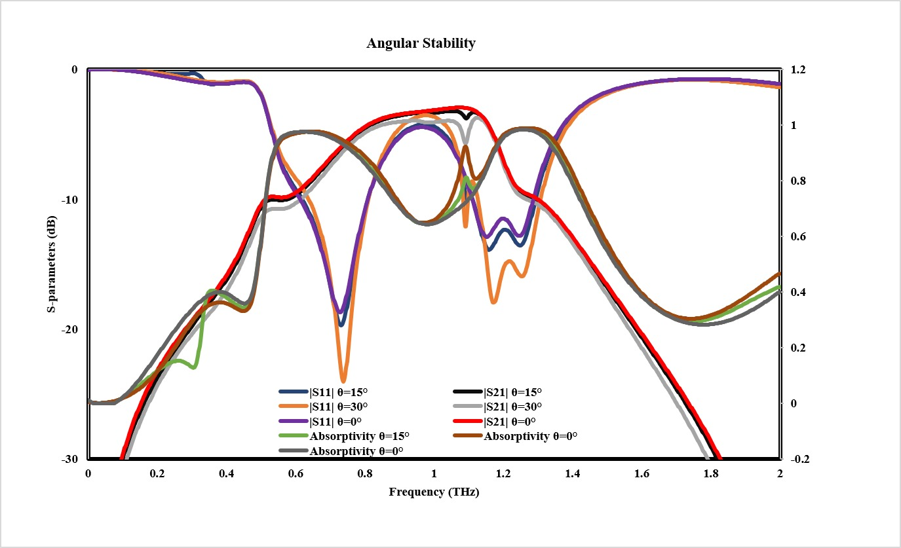
RESULTS
ANGULAR STABILITY – TM MODE
Passband stays at ≈1.07 THz with ≈3 dB insertion loss at 0° and 15°; at 30° it becomes a broad plateau (≈0.9–1.08 THz), rising only ≈0.5 dB.
Broadband change: the absorption bands (≈0.54–0.77 THz and ≈1.18–1.35 THz, absorptivity ≥ 0.9) keep the same limits and peaks, so FBW ≈35.1% and ≈13.4% is unchanged with angle.
S11 minima deepen at larger angle (≈ −18.5 dB at 0° to ≈ −24.5 dB at 30°), so the wave is still absorbed; the 0.2λ₀ cell keeps the response stable up to 30°.
Fig.6 : TM mode: θ = 0°, 15°, 30°

Slide 28
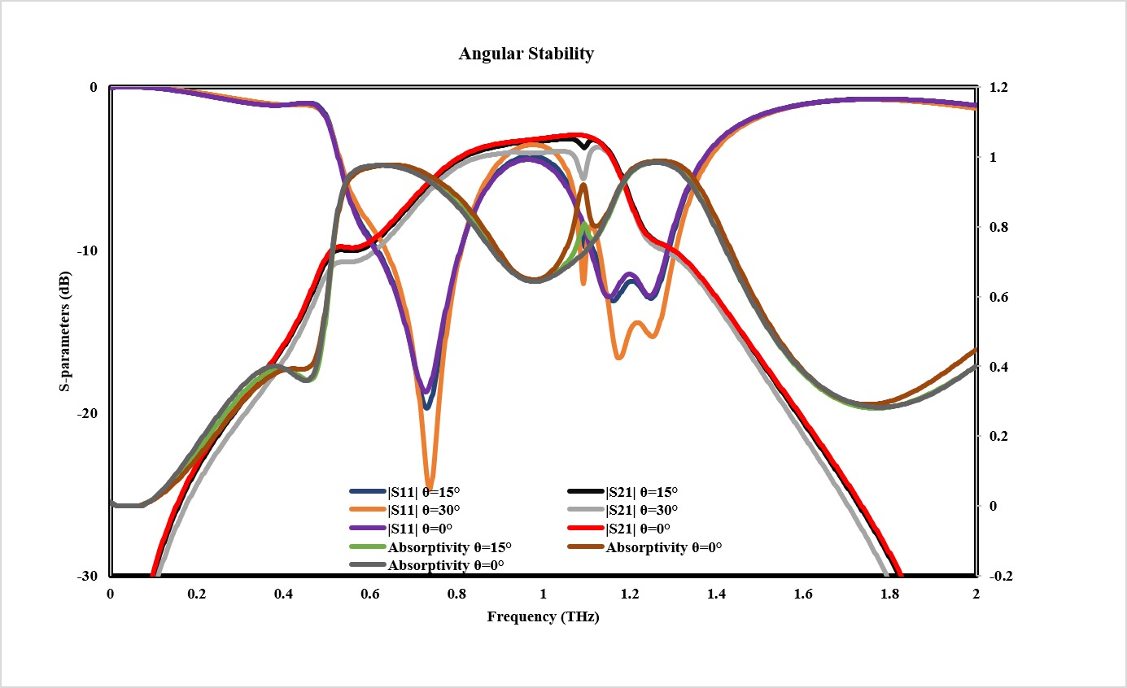
RESULTS
ANGULAR STABILITY – TE MODE
TE mode follows the same trend as TM: passband at ≈1.07 THz with ≈3 dB insertion loss, broad plateau (≈0.9–1.08 THz) at 30° with only ≈0.5 dB rise.
Broadband change: the absorption bands (≈0.54–0.77 THz and ≈1.18–1.35 THz, absorptivity ≥ 0.9) keep the same limits and peaks, so FBW ≈35.1% and ≈13.4% is unchanged with angle.
S11 minima deepen at larger angle (≈ −18.5 dB at 0° to ≈ −24.5 dB at 30°); the 0.2λ₀ cell keeps the response stable up to 30°.
Fig.7 : TE mode: θ = 0°, 15°, 30°

Slide 29
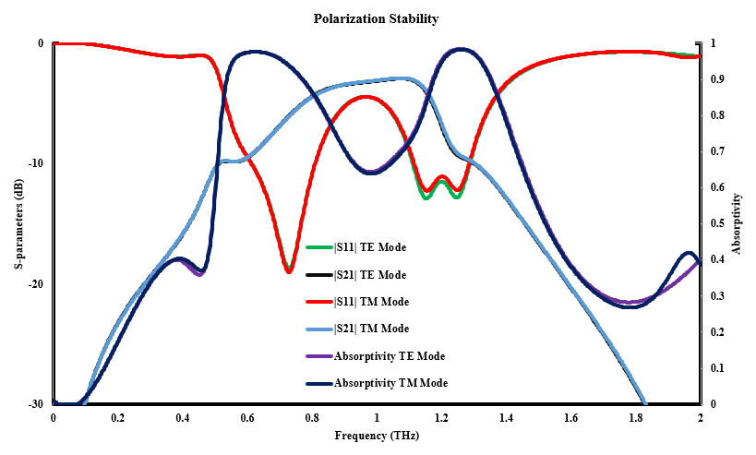
RESULTS
POLARIZATION STABILITY (TE & TM)
Parameter | TE (φ = 0°) | TM (φ = 90°)
Passband centre | ≈ 1.07 THz | ≈ 1.07 THz
Peak S21 (insertion loss) | ≈ −2.95 dB | ≈ −2.95 dB
Deepest S11 | ≈ −19 dB @ 0.73 THz | ≈ −19 dB @ 0.73 THz
Peak absorptivity | ≈ 0.98 | ≈ 0.98
Absorptivity ≥ 0.9 | 0.54–0.77, 1.18–1.35 THz | 0.54–0.77, 1.18–1.35 THz
FBW (lower band) | ≈ 35.1 % | ≈ 35.1 %
FBW (upper band) | ≈ 13.4 % | ≈ 13.4 %
Fig.8 : TE (θ = 0°, φ = 0°) and TM (θ = 0°, φ = 90°)
TE and TM modes overlap almost exactly over 0–2 THz: S11 differs by only ≈0.5 dB near 1.15 THz and absorptivity by ≤0.03, outside the passband and main absorption peaks.
Broadband change: none – passband (≈1.07 THz, insertion loss ≈3 dB) and both absorption bands (FBW ≈35.1% and ≈13.4%) are identical for TE and TM.
Polarization stable at normal incidence due to the 0.2λ₀ unit cell and the near-symmetric folded fractal transmission pattern.

Slide 30
TIMELINE
PHASE | TASK
Phase 1 | Literature review, identification of the research gap, and selection of materials (SiO₂, gold, and graphene) for the sub-THz FSR design
Phase 2 | Design and optimization of the miniaturized transmission layer using a folded fractal resonator to achieve a 1 THz resonance
Phase 3 | Design and optimization of the graphene-loaded absorption layer using a high-turn spiral resonator, achieving 69.89% fractional bandwidth
Phase 4 | Integration of the transmission and absorption layers into a single-layer hybrid FSR and analysis of the combined spectral response
Phase 5 | Performance evaluation through fractional bandwidth calculations, angular stability analysis (0°, 15°, 30°), and TE/TM polarization stability analysis

Slide 31
References
An Optically Reconfigurable Wideband Frequency-Selective Rasorber/Absorber at the Terahertz Band, 2025.
A THz Smart Switch Based on a VO₂ Metamaterial that Switches Between Wide-Angle Ultra-Wideband Absorption and Transmission, Dalton Transactions, Royal Society of Chemistry, 2024.
Bifunctional Terahertz Metamaterial Device with Switchable Properties Between Transmission and Broadband Absorption, Optik, Elsevier, 2024.
Thermally Controlled Multifunctional Metamaterial Absorber with Switchable Wideband Absorption and Transmission at the Terahertz Band, 2023.
VO₂-Based THz Device with Switchable Transmission and Absorption Characteristics, 2022.
Govindarajan, G., Alsath, M. G. N., Savarimuthu, K., & Kanagasabai, M., "A Meta-Analysis of Frequency Selective Rasorber (FSR)," International Journal of Microwave and Wireless Technologies, vol. 16, no. 9, pp. 1465-1480, 2024

Slide 32
THANK YOU​

